Slide 1
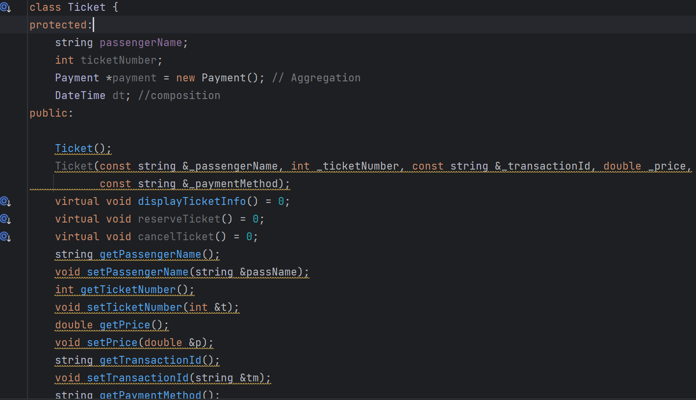
Ticket Abstract Class having Polymorphism

Slide 2
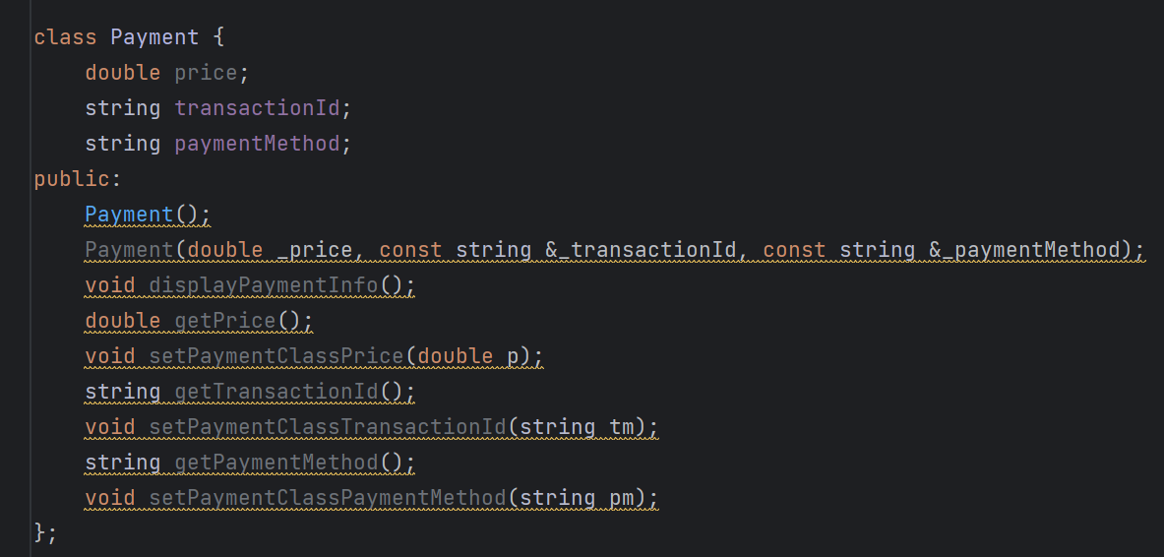
Payment Class Aggregated In Ticket

Slide 3
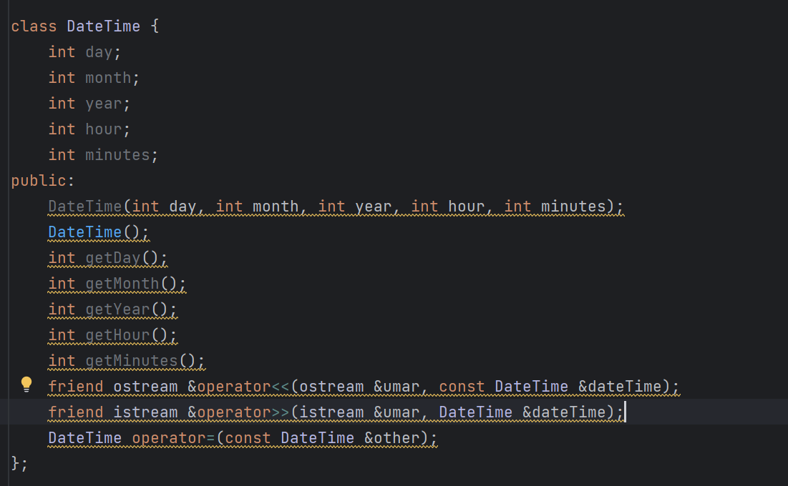
Date Time Class Composed In Ticket

Slide 4
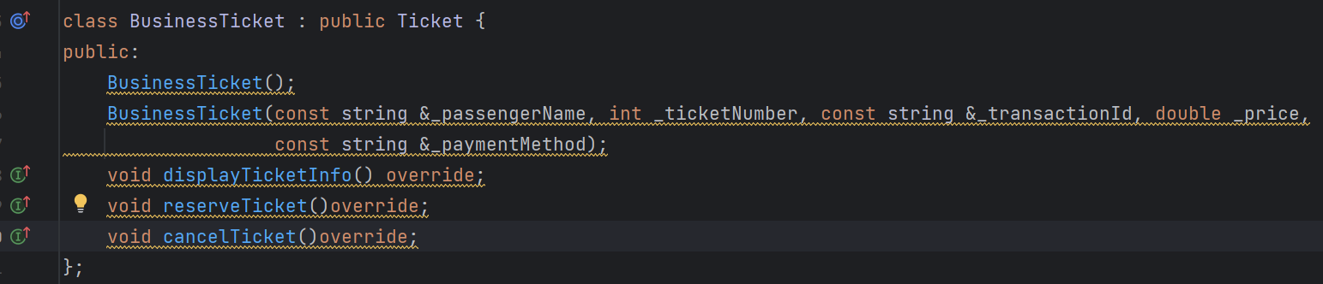
Business Ticket Class Inherits From Ticket

Slide 5
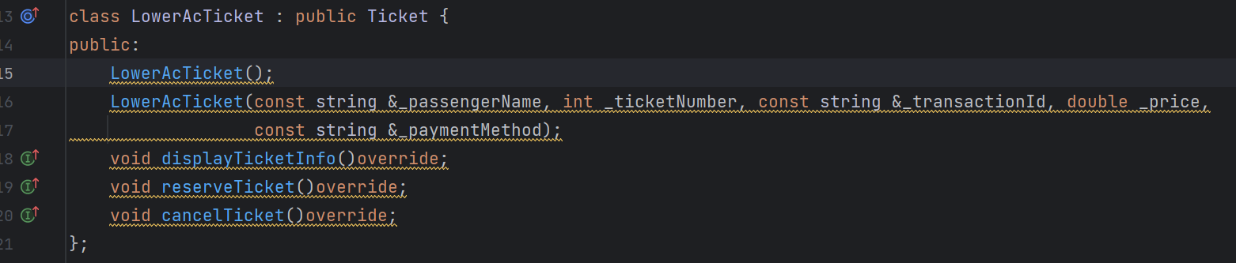
Lower AC Ticket Class Inherits From Ticket

Slide 6
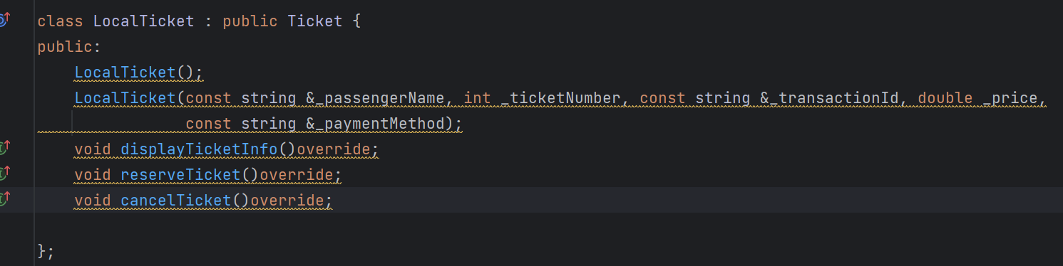
Economy Ticket Class Inherits From Ticket

Slide 7
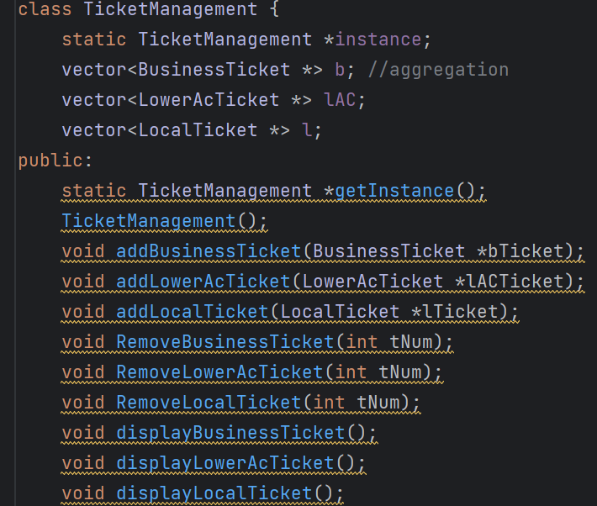
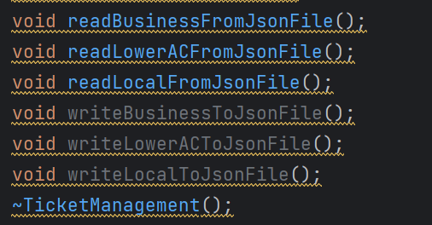
Ticket Management Class Adding And Removing Tickets

Slide 8
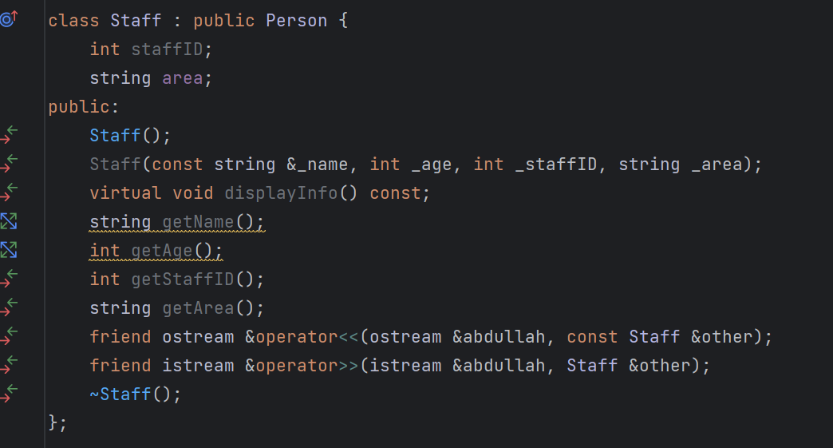
Staff Class Used in Other Functionalities

